Slide 1
Thoughts?
First Impressions?
Any Relevance?
Differences from Millennials?
Other?

Slide 2

Strategy Needs a Strategy
Notes:
https://www.youtube.com/watch?v=YE_ETgaFVo8

Slide 3
2 Laws Impacting Innovation in our Time
Moore’s Law – rate of technological change
Metcalfe’s Law – value of the network

Slide 4
Moore's Law
Moore's law is the empirical observation that at our rate of technological development, the complexity of an integrated circuit, with respect to minimum component cost, will double in about 18 months.
Notes:
http://en.wikipedia.org/wiki/Moore%27s_law

Slide 5
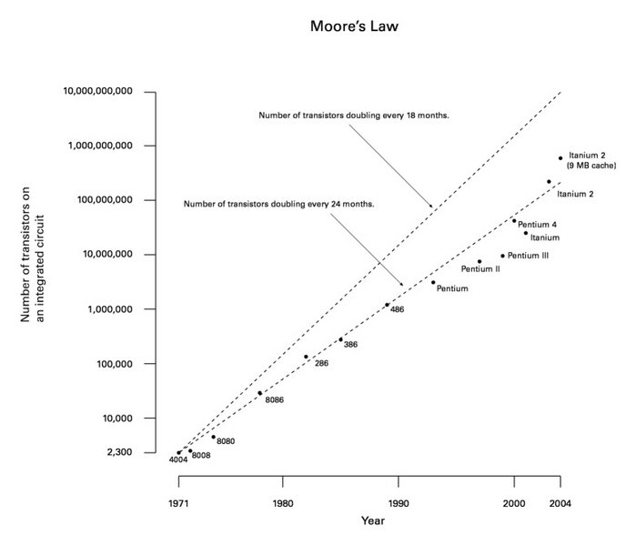
Moore's Law

Slide 6
Moore's Law
Although Moore's law was initially made in the form of an observation and prediction, the more widely it became accepted, the more it served as a goal for an entire industry. This drove both marketing and engineering departments of semiconductor manufacturers to focus enormous energy aiming for the specified increase in processing power that it was presumed one or more of their competitors would soon actually attain. In this regard it can be viewed as a self-fulfilling prophecy.

Slide 7
Moore's Law
Moore's law equates to an average performance improvement in the industry as a whole of over 1% a week. For a manufacturer competing in the cut-throat CPU market, a new product that is expected to take three years to develop and is just two or three months late is 10 to 15% slower, bulkier, or lower in storage capacity than the directly competing products, and is usually unsellable.

Slide 8
Moore's Law
Moore's Law of Integrated Circuits was not the first, but the fifth paradigm to provide accelerating price-performance. Computing devices have been consistently multiplying in power (per unit of time) from the mechanical calculating devices used in the 1890 U.S. Census, to Turing's relay-based "Robinson" machine that cracked the Nazi enigma code, to the CBS vacuum tube computer that predicted the election of Eisenhower, to the transistor-based machines used in the first space launches, to the integrated-circuit-based personal [computers].
—(Kurzweil net)

Slide 9
Implications for Innovation?

Slide 10
Metcalfe’s Law
Metcalfe's law explains many of the network effects of communication technologies and networks such as the Internet and World Wide Web.
Metcalfe's law states that the value of a network equals approximately the square of the number of users of the system (n²). 4 nodes = 16
  Sarnoff’s Law - The value of a broadcast network is directly proportional to the number of viewers
Notes:
http://en.wikipedia.org/wiki/Metcalfe's_Law

Slide 11
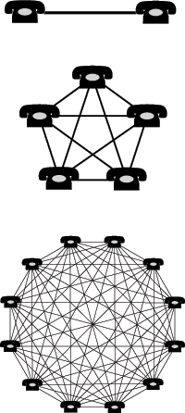
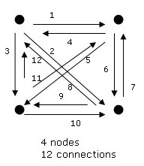
Notes:
4 doesn’t equal 16?

Slide 12
Applications of Metcalfe's Law
Metcalfe's Law can be applied to more then just telecommunications devices. Metcalfe's Law can be applied to almost any computer systems that exchange data.
Examples of devices include:
  Telephones; FAXs; Operating systems; Applications
Metcalfe's Law frequently predicts whether a single vendor or interface standard will tend to dominate a marketplace. This has implications for whether an innovative solution can enter a marketplace that requires different interfaces.

Slide 13
Applications of Metcalfe's Law
The same law can be applied to other technological systems, such as personal genome sequencing. As more human genomes are sequenced and tied to personal health information in an interconnected system, the value of the information that a personal genome can contribute to personal health grows.
Can you think of any applications?
The power of Metcalfe’s law is probably overstated:
http://www.dtc.umn.edu/~odlyzko/doc/metcalfe.pdf

Slide 14
Modified Models
Within the context of social networks, many, including Metcalfe himself, have proposed modified models using (n × log n) proportionality rather than n² proportionality.[ Reed and Odlyzko have sought out possible relationships to Metcalfe's Law in terms of describing the relationship of a network and one can read about how those are related.

Slide 15
Value of an Online Encyclopedia
http://www.ted.com/talks/jimmy_wales_on_the_birth_of_wikipedia.html
Jimmy Wales recalls how he assembled "a ragtag band of volunteers," gave them tools for collaborating and created Wikipedia, the self-organizing, self-correcting, never-finished online encyclopedia.

Slide 16
Management Systems: Designing the Process of Innovation
Chapter 5

Slide 17
Systems & Processes Make Things Happen
This is also what the Innovator’s Toolkit text is all about

Slide 18
Designing the Innovation Process
The five roles of an innovation system:
Efficiency
  Increase efficiency of the innovative process – speed, minimum use of resources
Communication
  Within and outside the organization
Coordination
  Between projects, teams
Learning
  More in CH 8
Alignment
  Align objectives of business units with company strategy

Slide 19
Designing the Innovation Process
The Innovation Process fig 5.2 page 125
  Idea funnel:
    Generation of ideas → selection → executions → Creation of value

Slide 20
Systems for Ideation: Seeing the Gaps
The management challenge is to create an environment to nurture the generation of large quantities of great ideas about gaps (without getting in the way of day-to-day business)
The challenge is to nurture the generation of economically viable ideas and to move a manageable number through the innovation process.

Slide 21
Structured Idea Management (SIM)
– see fig 5.4 page 129
SIM Goals:
Control of the working context/environment
Use the best screening mechanisms
Recognition systems to bundle or cluster “idea fragments” to create breakthroughs

Slide 22
SIM designed to prevent confusion in the two following areas:
  Understanding the difference b/w assessing incremental versus radical ideas
    Need different approach to decision-making, approval process
  Recognizing the value of idea fragments
    Give attention to individual and combinations of ideas/fragments and their potential value

Slide 23
Experimentation
Radical innovation relies on ongoing experiments that test, refute, modify, and validate potential radical breakthrough concepts
Experiments provide a probing dynamic into new technical, business, and market spaces.
Provide insight and uncover hidden value
Learning opportunity

Slide 24
Prototyping
Think modularly
  Work on smaller sections instead of the whole
Fail fast and cheaply
  Set up small practical tests
Fail often in order to succeed faster
  Learn from failures

Slide 25
Making Deals
Innovation ideas need to be “sold” to investors
  Or to internal decision-makers for approval to continue

Slide 26
Innovations That Fit
Focus innovation on enhancing core competencies (business model, markets, technologies essential to compete)
  Can be limiting/ miss opportunities; or
  Going outside your competencies could be disastrous
Notes:
Famous Amos – Wally Amos – The Cookie Kahuna

Slide 27
Management System Comparison
System comparison between Incremental and Radical Innovation
-See table 5.1 pages 137-8

Slide 28
Management Systems and the Innovation Rules
Systems must be combined so that they can manage the dualities of the following:
  Technology and business models
  Radical and incremental innovation
  Creativity and value capture
  Networks and platforms

